Slide 1

Smart Plant Irrigation with Blynk Server: Wireless Control
Author: Băliban David-Simeon
Technical University of Cluj-Napoca

Slide 2

Introduction
Smart-homes
What’s the purpose of the study?
-- An automated plant watering system using IoT --
Why?
time management
convenience
Components: NodeMCU board, soil moisture sensor, water pump, battery, relay and conenctors
Have a precise control
Remote access

Slide 3

Purpose
Better for the plants – precision
The importance of a good irrigation
- overwatering and underwatering
Better for us – minimum intervention
Remote controlliong

Slide 4
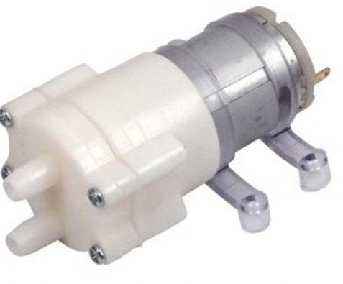
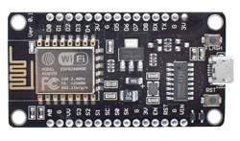


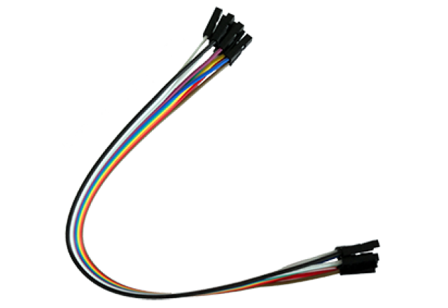
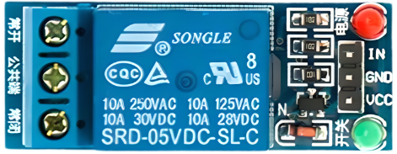
System overview - Components
NodeMCU ESP8266 Microcontroller
Capacitive sensor
Water pump
Relay
Connectors

Slide 5
IoT implication
WiFi technology
Blynk server
Benefits

Slide 6
System implementation
Functionality Diagram

Slide 7
System implementation
Connections Schema

Slide 8
Conclusion
In summary, this study presents an Automated Plant Irrigation
System utilizing the Blynk server.
Integrating components alongside the Blynk platform
minimizes human intervention
precise watering
This addresses the need for automated solutions to simplify
household tasks.
Carefully selected components and harmonious integration
efficient operation

Slide 9

Thank you for your attention!
Q & A Time

